Slide 1
Presentation on Introduction to Computer

Slide 2
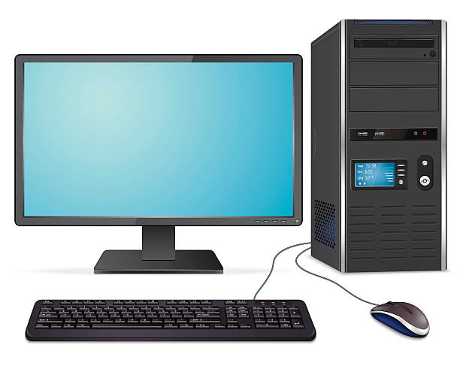
Introduction
Derived from the word ‘computare’ which means to calculate
Accept data manipulate it and then process the data and display the output
Takes input from Input devices like keyboard, mouse etc.
Display output from output devices i.e. monitor

Slide 3
Characteristics of Computer
Word length
Speed
Accuracy
Diligence
Versatility
Storage
Automatic
Power of remembering

Slide 4
Word Length
A digital computer operates on binary digit 0 and 1
Numbers of bits a computer can process at a time is word length.
Are varies such as 8,16,32 or 64 bits
Longer the Word length, the more powerful the computer is
16 bits computer means 16 bit of world length
Speed
Time taken by computer to perform a task is called speed of computer
Computers work very fast
Computer takes few second to do a calculation that we take hours to calculate

Slide 5
Accuracy
Is accurate machine
Degree of accuracy is very high
Perform large task without error
Diligence
Perform task without any tiredness or lack of concentration
Can work hour without any error
Millions of calculation is performed with same accuracy

Slide 6
Storage
Can store a large volume of data
Has huge storage section
Storage capacity is measure in term of kilobyte, megabyte ,gigabyte and terabyte
Automatic
Is an automatic machine
Operates automatically once appropriate set of instruction is given
Without user intervention it operates automatically

Slide 7
Versatility
computer can perform different kinds of works with same accuracy and efficiency
Is flexible can perform both complex and simple task
Power of Remembering
Computer can store any amount of data
Any data or information can be stored and recalled as long as you require

Slide 8
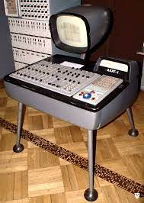
Analog Computer
Used to process analog data
Store data in a continuous form of physical quantities and perform calculations with the help of measures
Data is not discrete, but rather is of a continuous nature
Examples of such data are pressure, temperature, voltage, speed and weight

Slide 9
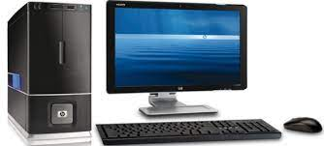
Digital Computer
Can be considered as a digital system that performs various computational tasks
Use the binary number system, which has two digits: 0 and 1
Solve problem by processing information in discrete form

Slide 10
Generation of computer
First generation
Second generation
Third generation
Fourth generation
Fifth generation

Slide 11
1.First generation computer(1945-1954)
Main electronic component – vacuum tube
Main memory – magnetic drums and magnetic tapes
Programming language – machine language
Power – consume a lot of electricity and generate a lot of heat.
Speed and size – very slow and very large in size (often taking up entire room)
Input/output devices – punched cards and paper tape.

Slide 12
2.Second generation computer(1955-1964)
Main electronic component – transistor
Memory – magnetic core and magnetic tape / disk
Programming language – assembly language
Power and size – low power consumption, generated less heat, and smaller in size (in comparison with the first generation computers).
Input/output devices – punched cards and magnetic tape.

Slide 13
3.Third generation of computer(1965-1979)
Main electronic component – integrated circuits (ICs)
Memory – large magnetic core, magnetic tape / disk
Programming language – high level language (FORTRAN, BASIC, Pascal, COBOL, C, etc.)
Size – smaller, cheaper, and more efficient than second generation computers (they were called minicomputers).
Input / output devices – magnetic tape, keyboard, monitor, printer, etc.

Slide 14
4.Fourth generation of computer
Main electronic component – very large-scale integration (VLSI) and microprocessor.
VLSI– thousands of transistors on a single microchip
Memory – semiconductor memory (such as RAM, ROM, etc.)
Programming language – high level language (Python, C#, Java, JavaScript, Rust, Kotlin, etc.).
size – smaller, cheaper and more efficient than third generation computers.
Input / output devices – keyboard, pointing devices, optical scanning, monitor, printer, etc.

Slide 15
5.Fifth generation of computer
Main electronic component: based on artificial intelligence, uses the Ultra Large-Scale Integration (ULSI) technology and parallel processing method.
Language – understand natural language (human language).
Power – consume less power and generate less heat.
size – portable and small in size, and have a huge storage capacity.
Input / output device – keyboard, monitor, mouse, trackpad (or touchpad), touchscreen, pen, speech input (recognise voice / speech), light scanner, printer, etc.

Slide 16

Application of computer
Banking
Education
Hospital
Entertainment
Industry
Banking
Arts

Slide 17
Banking:
In the banking sector, computers are used to store details of customers and conduct transactions, such as withdrawal and deposit of money through ATMs. Banks have reduced manual errors and expenses to a great extent through extensive use of computers.
Education:
Computers are used in education sector through online classes, online examinations, referring e-books, online tutoring, etc. They help in increased use of audio-visual aids in the education field.
Hospital:
Computers are used in hospitals to maintain a database of patients’ history, diagnosis, X-rays, live monitoring of patients, etc. Surgeons nowadays use robotic surgical devices to perform delicate operations, and conduct surgeries remotely. Virtual reality technologies are also used for training purposes. It also helps to monitor the fetus inside the mother’s womb.

Slide 18
Entertainment:
Computers help to watch movies online, play games online; act as a virtual entertainer in playing games, listening to music, etc. MIDI instruments greatly help people in the entertainment industry in recording music with artificial instruments. Videos can be fed from computers to full screen televisions. Photo editors are available with fabulous features.
Industry:
Computers are used to perform several tasks in industries like managing inventory, designing purpose, creating virtual sample products, interior designing, video conferencing, etc. Online marketing has seen a great revolution in its ability to sell various products to inaccessible corners like interior or rural areas. Stock markets have seen phenomenal participation from different levels of people through the use of computers.

Slide 19
Arts:
Computers are extensively used in dance, photography, arts and culture. The fluid movement of dance can be shown live via animation. Photos can be digitized using computers.

Slide 20
History of computer
There is a long history of the computer and computing devices. Generally, the history can be categorized into the following three different Eras which are given below:
Mechanical calculating Era
The Electro mechanical Era
The Electronic Era

Slide 21
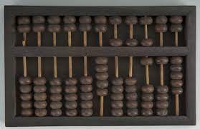
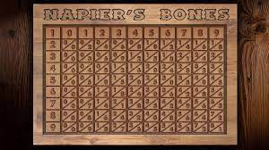
1. Mechanical Calculating Era
Based on counting principles
Based on decimal number system
Constructed with mechanical parts for counting
Device invented in mechanical era are:
Abacus
Napier’s Bone
Slide Rule
Pascaline

Slide 22
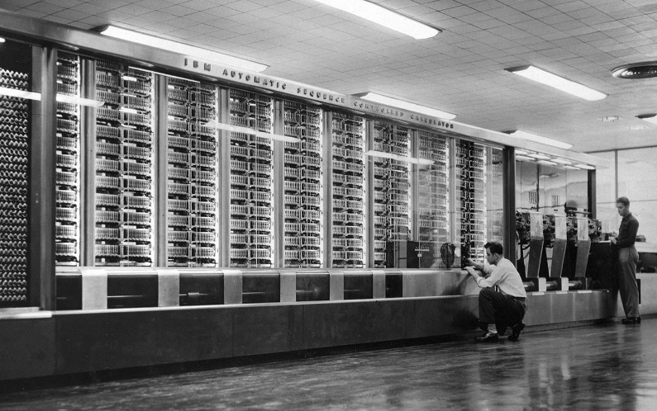
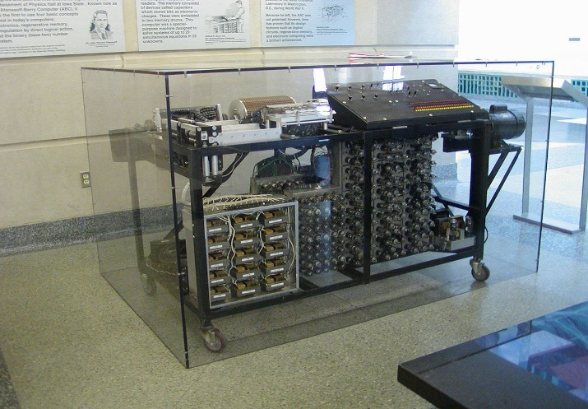
2. The Electro mechanical Era
Composed with mechanical as well as electrical parts
Partially programmable
Common computer of this era are:
Atana soft-berry computer(ABC)
Mark-I

Slide 23
3. The Electronic Era
Begins with invention of first real computer
Fully driven by electronic devices as component of computer
Most common machines invented during this era are:
Electronic Numerical Integrator and Calculator(ENIAC)
Electronic Discrete Variable Automatic Computer(EDVAC)
Electronic Delay Storage Automatic Computer (EDSAC)
Universal Automatic Computer (UNIVAC)

Slide 24
Classification of computer
There are the various types of computer that are used in the modern world. These computer fall under the following basis
On the basis of Work
On the basis of Size
On the basis of Model
On the basis of brand
On the basis of purpose

Slide 25
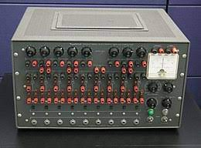
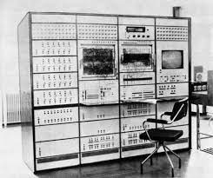
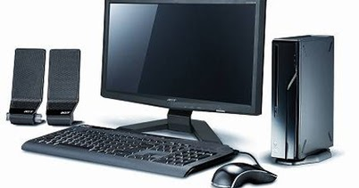
On the basis of work
Analog computer
Digital computer
Hybrid computer

Slide 26
Analog computer:
The computer work with physical values as temperature, pressure
Computer are based with continuous data
Computers has low accuracy
Cost is low and portable
Storing capacity is low
Digital computer:
These computer work with binary digit (0 and 1s)
Computers are based on discrete data
Computers have high accuracy
Cost is expensive and not easily portable
Has high storage capacity

Slide 27
Hybrid Computer:
These computers can work with binary digit and analog signal
Computers are based on both discrete and continuous data
It is intermediate in speed
Intermediate in accuracy

Slide 28
On the basis of Model
XT Computer (Extra computer)
AT Computer (Advance computer)
PS/2 Computer

Slide 29
XT computer (Extra technology):
Cannot support graphical user interface(GUI) based operating system
Processing speed is 4.77 MHz
AT/2 Computer (Advance Technology):
Support graphical user interface(GUI) based operating system
processing speed is 3 GHz
PS/2 computer
It is a laptop computer with rechargeable battery and battery base system

Slide 30
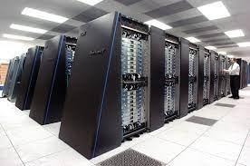
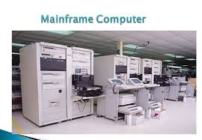
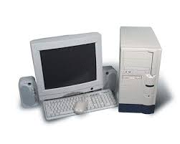
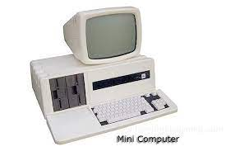
On the basis of size
Super computer
Mainframe computer
Micro computer
Mini computer

Slide 31
Super computer
These computer are largest, fastest and most expensive
Large memory capacity
High processing speed
Highly efficient and accurate
Used in designing automobile and aircraft, forecasting weather
Mainframe computer
Very powerful multi-user computer
Large storage capacity
Very high processing speed that support large number of terminals
Used in large business organization for processing complex data and problems

Slide 32
Mini computer
These computer are medium in size that is bigger than macro computer but smaller than mainframe
These computer are cheap and easy to use than mainframe computer
Used in medium sized business, banks, industries etc
Micro sized computer
These computer is smallest computer of all times
Micro processor as its CPU
Extensively used in homes and offices
Computers are cheap and compact, easily accommodated on study table

Slide 33
On the basis of Brand
IBM PC
Apple/Macintosh Computer
IBM Compatible

Slide 34
IBM PC
The personal computer was built by IBM company itself called IBM PC
These computer are reliable durable and have better quality than IBM compatible
They are costly than IBM Compatible
IBM Compatible
Computer which are produced rather than IMB company is known as IBM Compatible
These computer are cheaper as their parts are available in the market
These computer are less reliable and durable

Slide 35
Apple/Macintosh Computer
The apple series of micro computer were developed by Steve Wozniak and Steve jobs
These computer used 8-bit microprocessor which had mouse and key board in them
They were expensive in price

Slide 36
On the basis of purpose
General purpose computer
Special purpose computer

Slide 37
General purpose computer:
These computer are used for standard purpose
They aren’t made for a special purpose
These computer are made for people for their daily use
Special purpose computer
These computer are used for special purpose only
These computer are made applicable on particular area
Have limited area of application

